Slide 1

KS1 Mathematics Parent Information Evening 4th February 2020

Slide 2
Aims
To understand how and why we teach certain aspects of Number
To think about ways you ways you can help develop your child’s confidence and skills in maths

Slide 3



Slide 4
Understanding Number
Counting in 1s, 2s, 5s, 10s, 50s and 100s from different numbers
Place Value - understanding the value of each digit (Hundreds, Tens and Units)
0 as a place holder eg. 306
Sequencing and ordering numbers
Relationships eg. 10 units = 10, 10 tens = 100, 10 hundreds =1000

Slide 5
74+25=
Notes:
Count on – partition 74 + 20 + 5
70+20 +4+5=
75+25-1 (Rounding and adjusting)

Slide 6
Mental Maths
Focus is on understanding why and how they are calculating sums – often more than one way!
Children are encouraged to show their working out
Important before progressing onto vertical written methods
Notes:
7 strategies – in KS1 we focus on 5

Slide 7
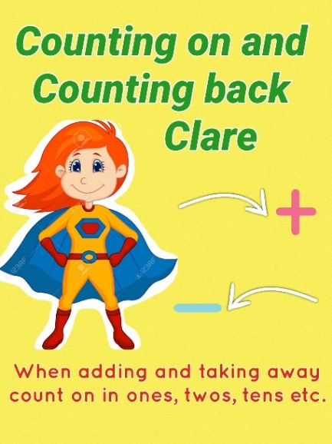
Counting on/Counting back
Counting on/back in 1s, 2s, 10s etc.
eg. 6+3=
19-5=
27+30=
Notes:
Use counters/fingers/hundred square to help initially

Slide 8
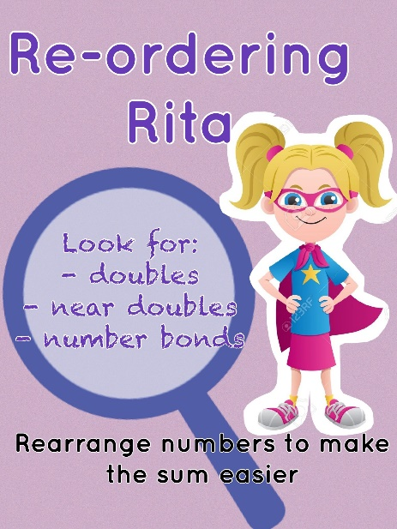
Reordering
3 + 6 = 6+3 (biggest number first)
4+5+6 –> rearranged to use number bonds to 10 to help: 4+6+5= 10+5= 15
8+3+8 –> rearranged to use doubles to help: 8+8+3= 16+3 = 19

Slide 9
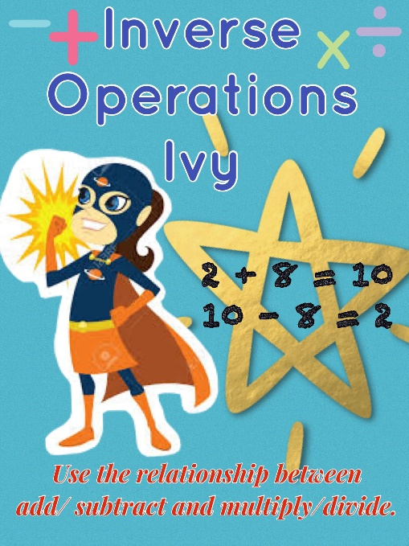
Inverse Operations
16+4=20
20-16=4
6x4=24
24÷6 = 4
Notes:
Use this to help check their answers
Useful for missing number sums

Slide 10
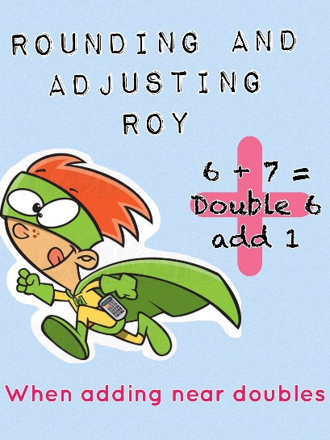
Rounding and Adjusting
useful when adding or subtracting numbers that
are close to a multiple of 10, 100 or 1000.
Near doubles: 6+7 = 6+6+1 = 12+1 = 13
or 7+7-1 = 14-1 = 13
+ 9 (+10-1)
+19 (+20-1)
-29 (-30+1)
-31 (-30-1)

Slide 11
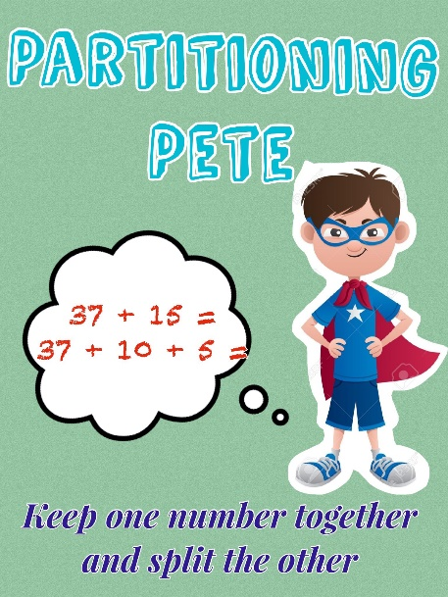
Partitioning
Splitting up one (or both) of the numbers into tens and units
not bridging the ten:
24+15=
24+10=34
34+5=39
bridging the ten:
35+26 =
35+20= 55
55+6 = 61

Slide 12
Table Facts
Number bonds to 10, 20, 100, 1000
Doubles & near doubles
+/- 10 & multiples of 10
+/-9
+/-11
Multiplication
Division
Notes:
Recall with speed

Slide 13
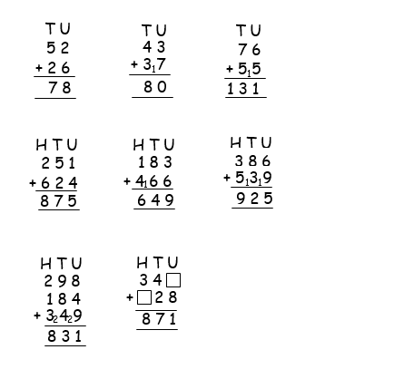
Vertical addition – bridging the ten/exchanging
- Knowledge and understanding of place value is key
Notes:
Gradual! This isn’t formally taught until P4. Understanding of place value needs to be really secure. Don’t want children to become reliant on this method – still want to encourage mental maths.

Slide 14
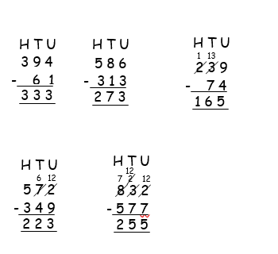
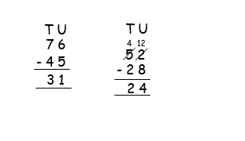
Vertical Subtraction - decomposition
Notes:
Big number on top
Start with units
Columns/houses

Slide 15
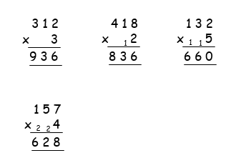
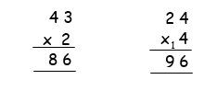
Multiplication and Division
Lots of practical activities to develop understanding of these concepts
Key vocabulary eg. sets, groups, times, lots of, product, multiples, sharing, split between
Multiplication: X10, x2, x5, x4, x3 in P4
Progress to vertical recording
Division: horizontal recording only
Notes:
Use a variety of language when practising at home
Vertical – towards end of year 4 – TU, HTU

Slide 16
Supporting your child at home
Create a positive view of mathematics
Help your child to understand the importance of mathematics in everyday life
Practise counting forwards and backwards in 1s, 2s, 5s, 10s starting from different numbers
Practise table facts daily to develop speed and confidence
Notes:
Counting – part of everday life; going up/down stairs, count colours of cars, play catch – count each time your throw, skipping rope, bouncing on trampoline – make it fun
Help children to see the value of learning these skills.
Value this practise – even if you think they know it, they must be confident and fluent with these skills and be able to apply these to different situations/problem solving activities etc.

Slide 17
Dice games
Throw dice and double the number
Throw two dice, add together and then double.
Throw two dice to make a two digit number (or three times to make a three digit number) eg. Roll a 3 and 7 = 37 or 73, roll the two dice again to make another two digit number – which number is bigger/smaller? can you add/subtract these numbers?
Card games (remove King, Queen, Jack)
Quick addition: Each player takes two cards, add together – highest total wins.
Each player takes 2/3 cards – make the biggest 2/3 digit number possible – highest wins – keep those cards. Continue until all cards used. Player with most cards at the end wins.
2 piles of cards – child takes one card from each pile and multiply these numbers together. (in one pile, only use number cards of multiplication sums covered so far eg. Remove 6,7,8,9 and use these in other pile
Add Up – players take it in turns to take one card from deck – this is starting number, take next card and add that number on..set a limit eg 50/100 – first person to reach this number wins.

Slide 18
Useful websites & apps
Topmarks.co.uk: ‘Hit the Button’ – number bonds, doubles, times tables
Topmarks.co.uk: ‘Daily Five’
ictgames.com: ‘Funky Monkey’
ictgames.com : ‘Shark Numbers’
Maths Splat
Operation Math
Mathland
Math Duel
Doodle Tables

Slide 19
Any questions?

